Slide 1

Four Step Process
Reading: 0.2
exercises: All chapter 0
Assigned: hw 1
Producer: dr. mario
img credit: alex riegert-waters

Slide 2
Four Steps of Statistical Modeling
Choose a form for the model
Fit that model to the data
Assess how well the model fits the data
Diagnostic Plots
Look for Patterns in the Residuals
Check Assumptions (Randomness, Independence, Normality)
Use the model to answer questions

Slide 3
Supplement for Lecture 2
Download Zip Folder on Course Website for Supplement
Unzip Folder on Your Computer
Open the Template.rmd File from the Unzipped Folder
Install Mosaic Package
Run First Two Code Chunks and View Dataset

Slide 4
Example: LEGO
Variable of Interest: Amazon_Price
Question of Interest:
How well can we predict the price of a LEGO set on Amazon without knowing any other information?

Slide 5

Form of Model
Constant Model:
The constant c is called a parameter
We use data to replace the unknown c with a sample estimate $\hat{c}$

Slide 6

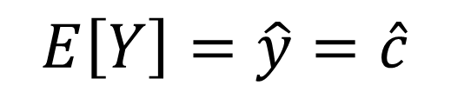
Fitting the Model to Data
For the constant model, if we want to estimate Y, then
The predicted y is denoted $\hat{y}$.
Good choices for $\hat{c}$
Sample Mean: $\hat{c}= \overline{y}=\frac{\sum{y_{i}}}{n}$
Sample Median: $\hat{c}=m_{Y}$
$$E\left[Y\right]=\hat{y}=\hat{c}$$

Slide 7
Assess Fit of Model
Question: Is the model good and which estimator is better?
Calculate residuals for each observation in data
Each observation has a residual so how do we summarize the overall fit?
$$residual=\hat{ε}=y −\hat{y}$$

Slide 8

Assess Fit of Model
Criteria for Assessing Fit (Loss Functions)
Sum of Residuals:
Sum of Squared Residuals:
Sum of Absolute Residuals:
$$∑(y−\hat{y})$$
$$∑{\left(y−\hat{y}\right)}^{2}$$
$$∑|y−\hat{y}|$$

Slide 9
Supplement for Lecture 2

Slide 10
Architecture of a Model
Explanatory Variable(s)
Error or Deviation from the Model
Response Variable
Generates an Expectation about Y given X

Slide 11
Statistical Modeling
Statistical Modeling is the Process of …
Defining the Function f(X) and then Fitting that Function f(X)
to a sample dataset by Minimizing the Error the best we possibly can
Methodology we Use Depends on the Types of Variables

Slide 12
Variable Types
Categorical
Quantitative
Nominal
Ordinal
Continuous
Discrete
LEGO Theme
LEGO Ages

Slide 13
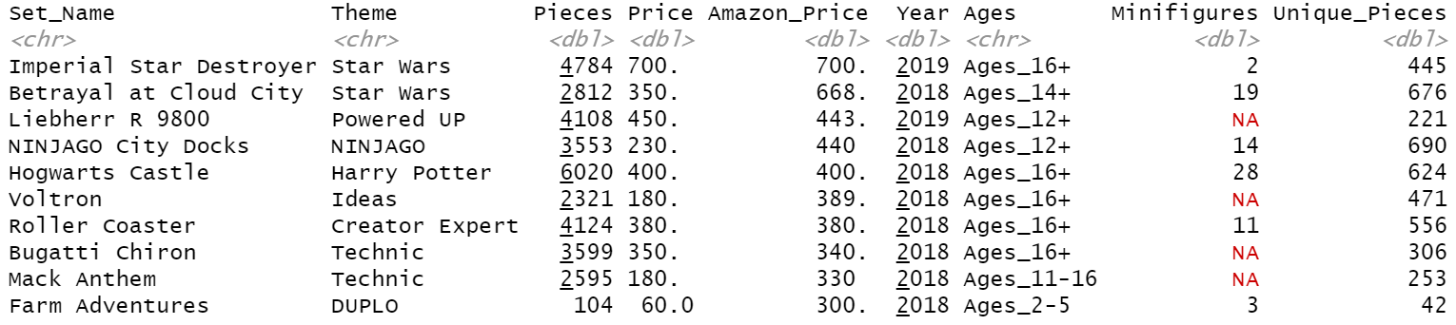
Preview of Dataset
Can we find all the variable types in this dataset?

Slide 14
Example of Variable Types Using LEGO
Categorical
Quantitative
Nominal
Ordinal
Continuous
Discrete
LEGO Theme
LEGO Ages
LEGO Price
LEGO Pieces

Slide 15
Families of Models
Complicated by multiple predictor variables and/or response variables
Response Variable
Predictor Variable
Categorical
Categorical
Quantitative
Quantitative

Slide 16
Technology We Will Use
R = a free, widely used, open source, language and environment for statistical computing and graphics
RStudio = an interface for R (Integrated Development Environment)
RMarkdown = a tool in R for creating documents that combine R code with text
Download R and RStudio to Your Computer

Slide 17
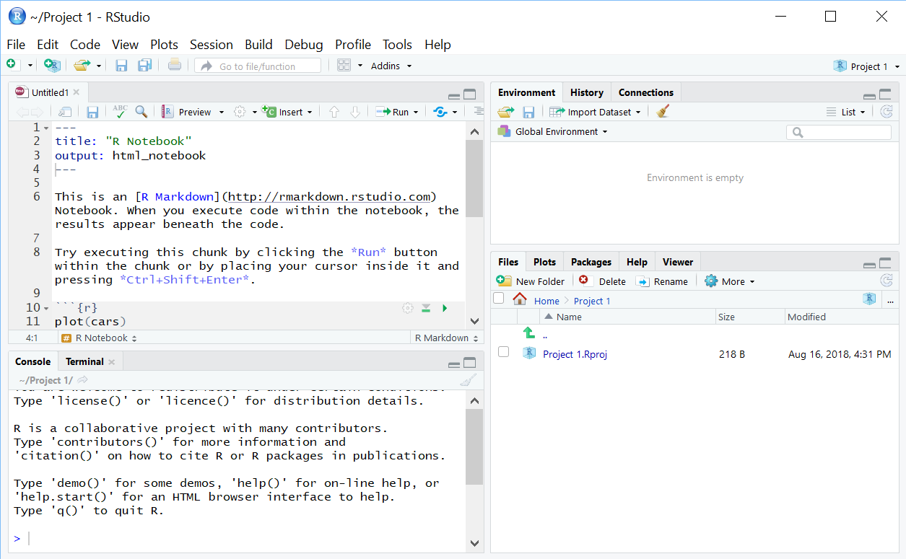
Quick Look at R Studio
Environment: lists active variables, functions, …
Editor: write/view code, data
Access files
View plots
Control packages
View help
Console: Enter commands, view output, error messages

Slide 18
Learning Objectives for R
Install Packages
Load Packages
Read CSV Files
Create Objects
Columns and Rows
Subset Data
Basic Statistical Functions

Slide 19
Thank You
Make Reasonable Decisions

